Slide 1

Milestone 4
Torque titans
Dániel Ferencz-csiki
Dániel Trubek
Nipun Guaranathe
Aws Abu Ali
Tanvir Tanjir Rohan

Slide 2
Choosing a suspension to use
 | Rocker-Bogie suspension | Leaf spring suspension | Macpherson strut suspension
Cost-effectiveness | 3 | 5 | 4
Suitability for heavy loads | 2 | 5 | 3
Durability | 5 | 3 | 2
Simplicity | 3 | 2 | 1
Terrain adaptability | 5 | 3 | 3
Ease of maintenance | 5 | 2 | 4
Stability | 5 | 3 | 3
Overall | 28 | 23 | 20
Rocker-Bogie
Leaf Spring
MacPherson Strut

Slide 3
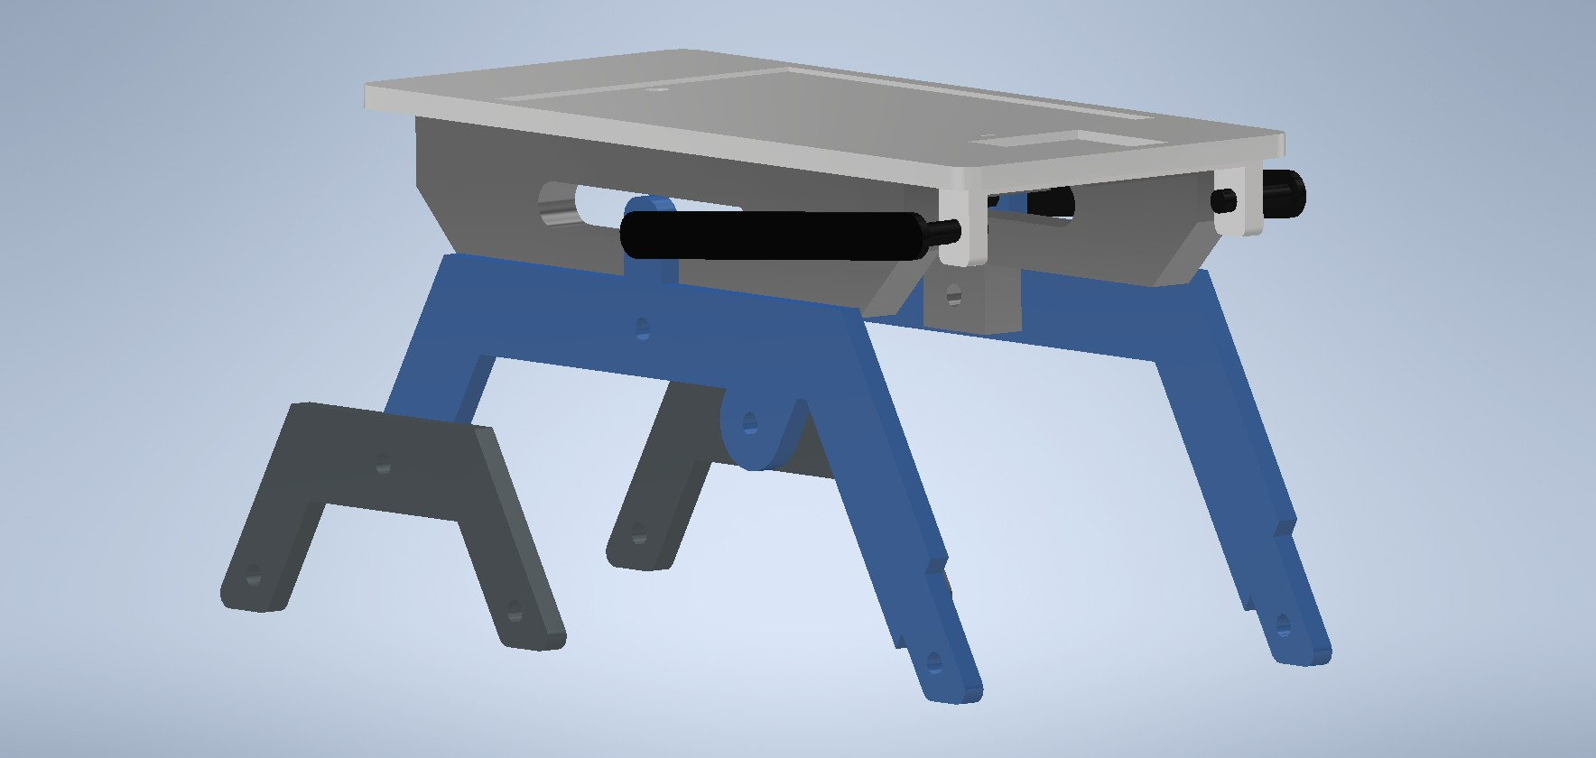
Early ideas and design
Design is just an approximation
A lot of problems to be solved

Slide 4
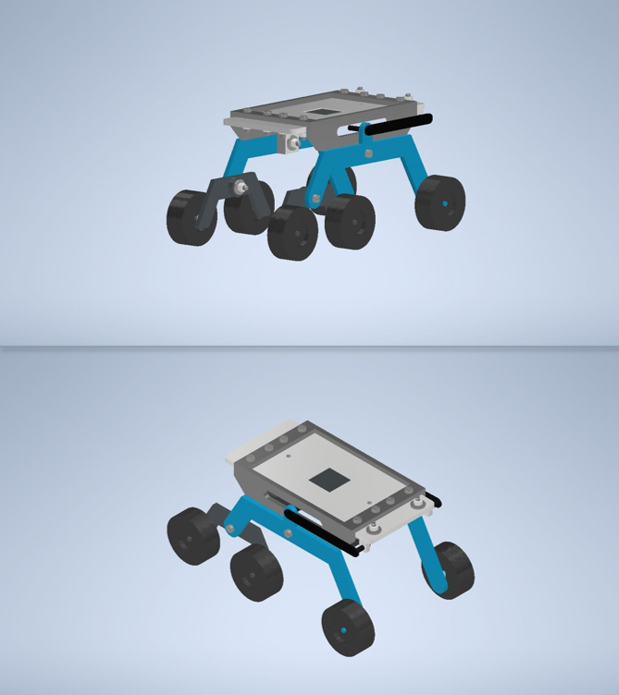
Improved design – more details added
Improved parts and assembly

Slide 5

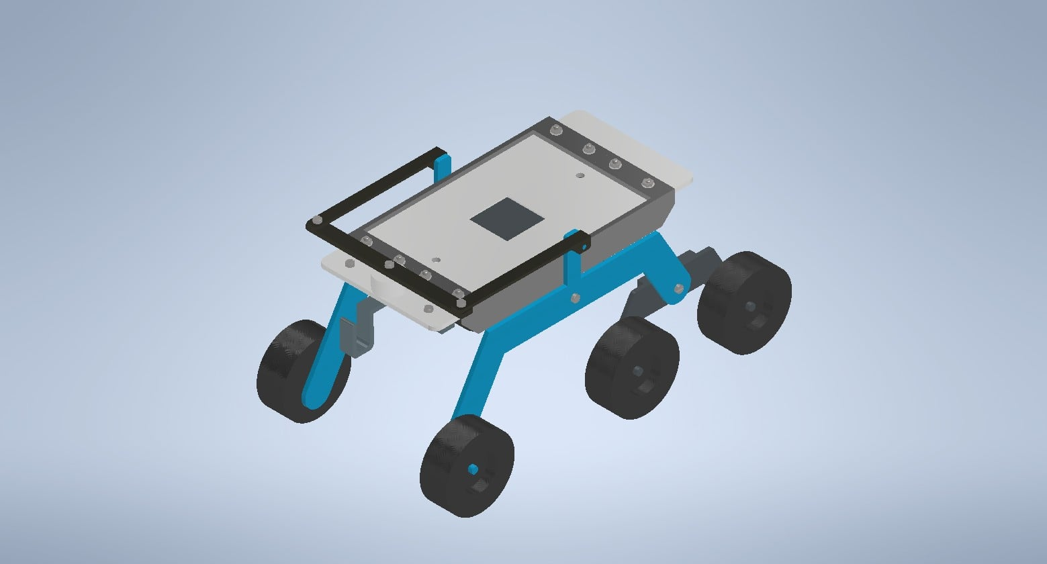
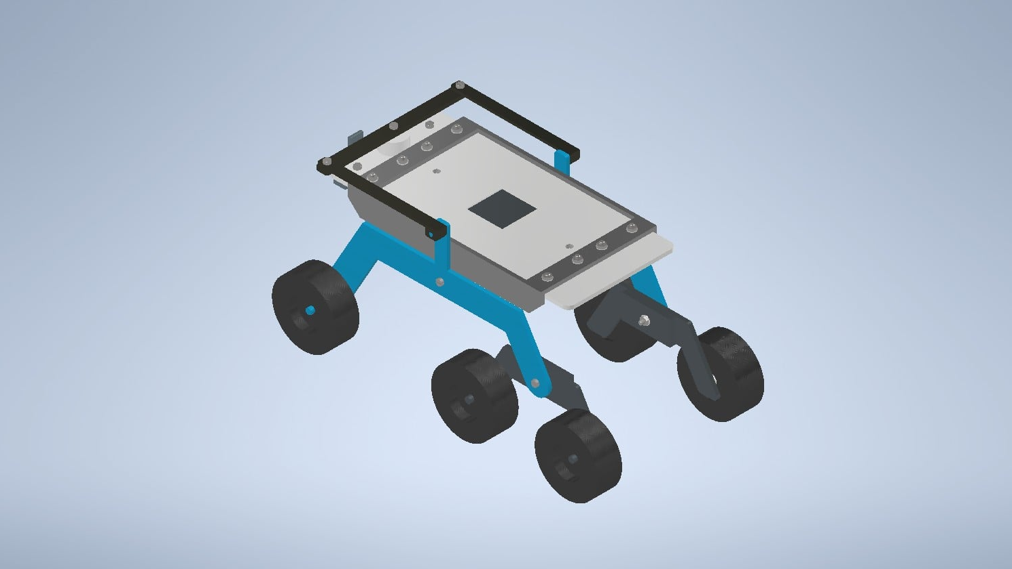
Final design
Changed differential
Hook added
Lowered center of mass

Slide 6
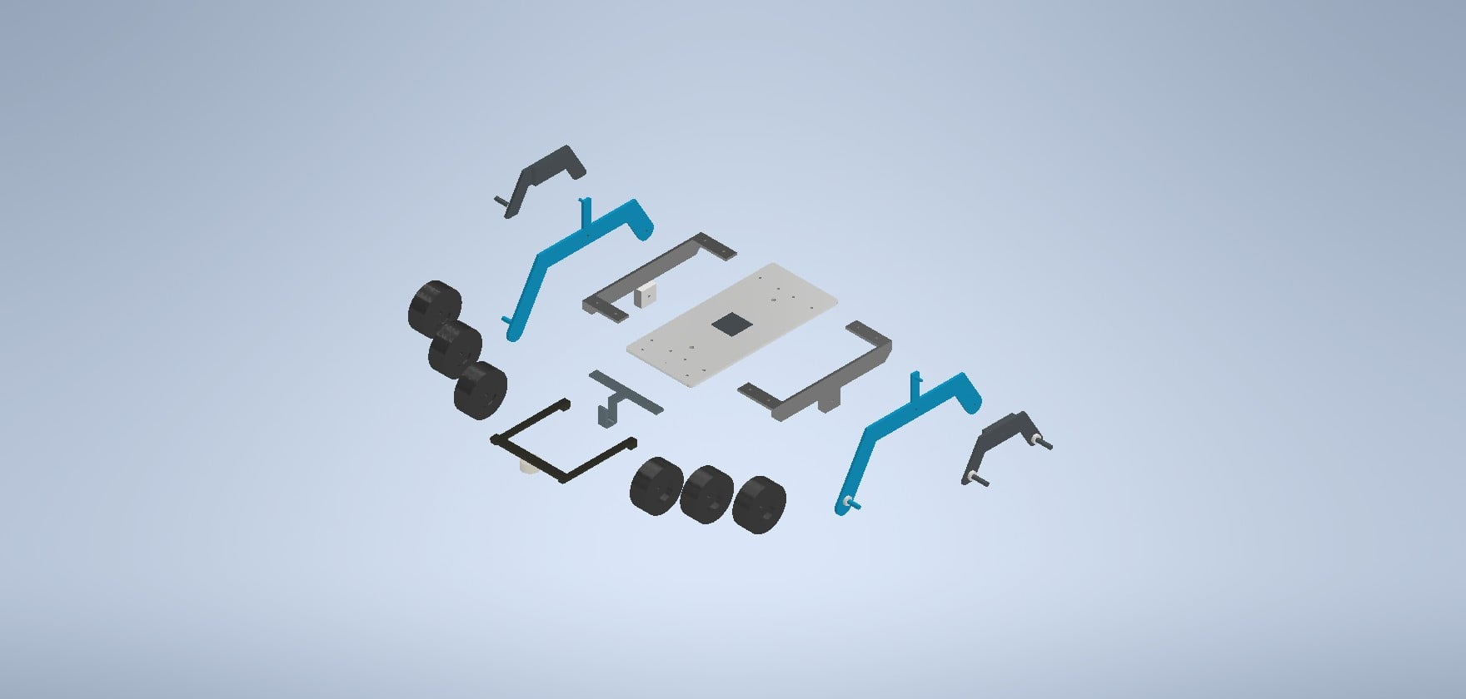
Components used

Slide 7
Assembly plan
Prepare the Base Frame
Assemble the Rocker-Bogie Arms
Attach the rocker arms (blue rocker arms) to the chassis
Secure thecbogie arms (smaller black arms) to the main rocker arms
Attach the Wheels
Attach the wheels to the rocker-bogie arms on both sides. Ensure the wheels are tightly secured and rotate freely.
Install the Support Brackets
Attach the black support brackets on the top of the chassis using screws or bolts.
These brackets may be used for stability or to hold additional components.
Final Tightening and Testing

Slide 8
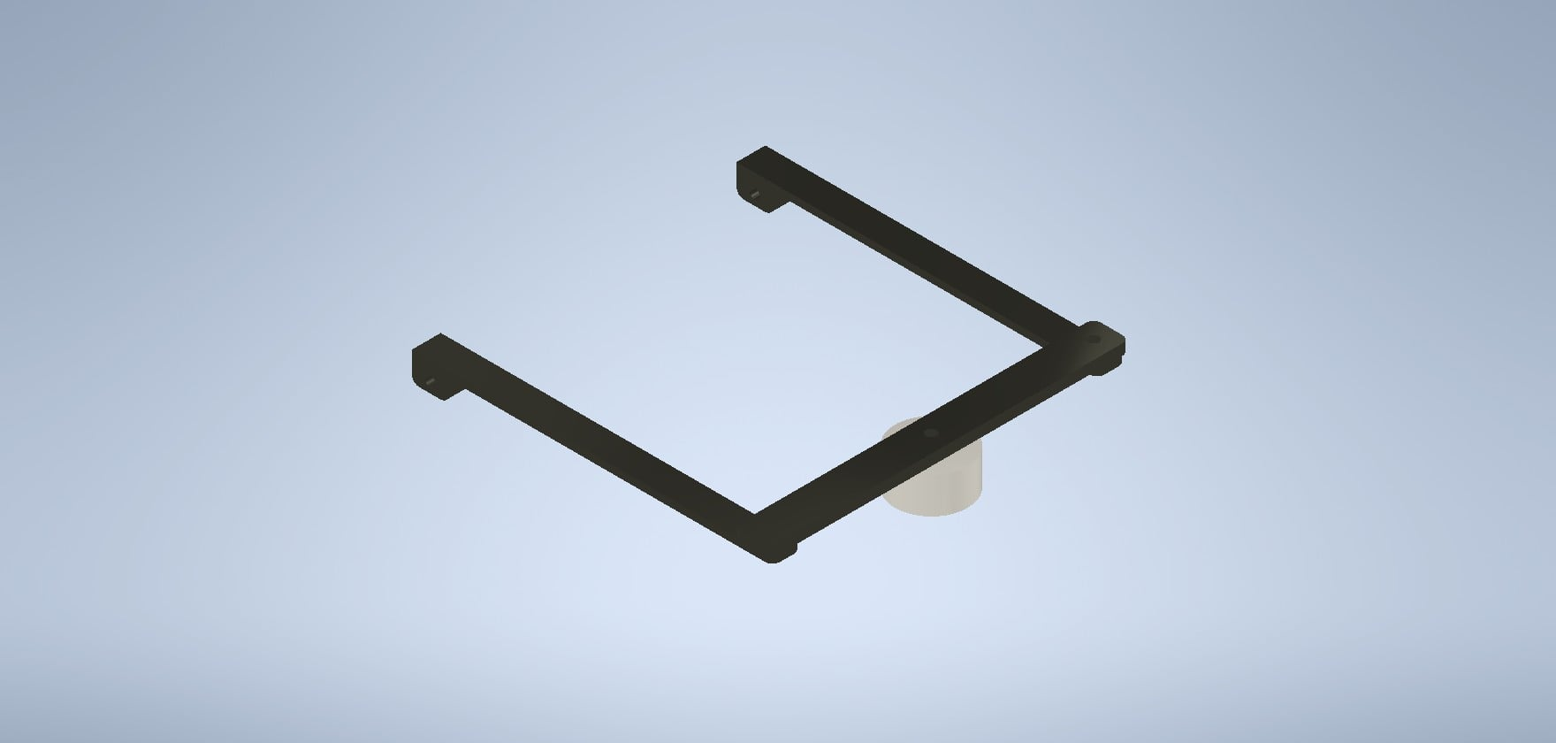
Changed differential
V2 design was not working
Easier construction

Slide 9
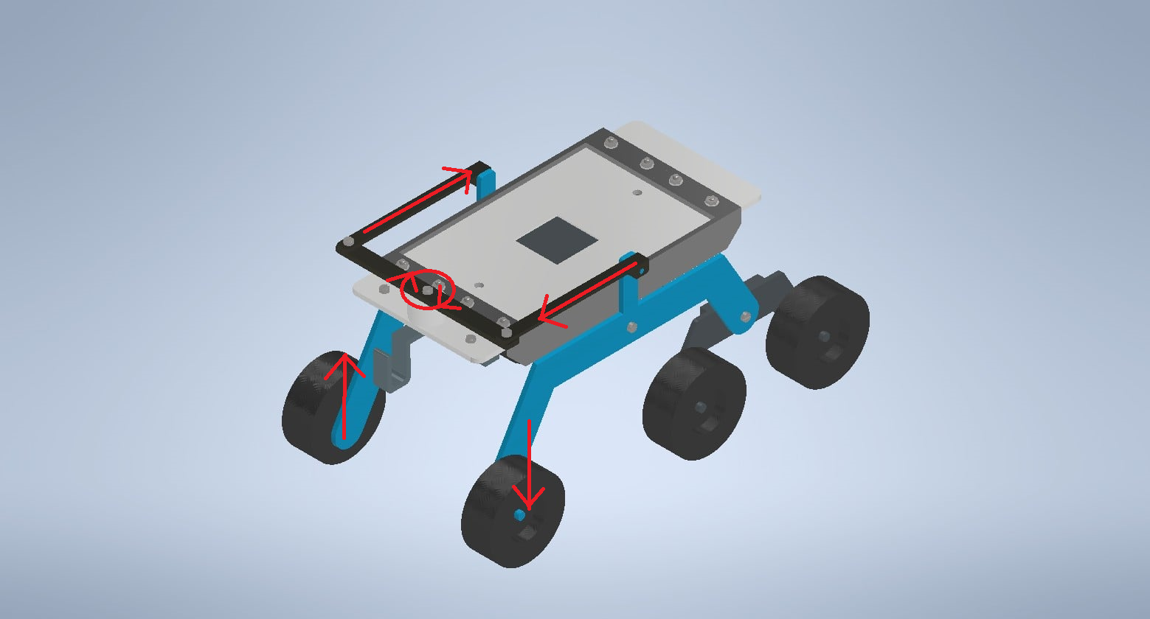
Changed differential

Slide 10
Budget plan approximation
Budget plan
Wheels | 720HUF/wheel - 4320HUF
Screws | Around 10HUF/each - 170HUF
Nuts | Around 5HUF/each - 85HUF
Washers | Around 2.5HUF/each - 42.5HUF
PLA Filament | Approximately 400g around 4000-5000HUF
ALTOGETHER | Approximately 4617.5HUF

Slide 11
Thank you for your attention

